Slide 1

Decision Tree

Slide 2
Decision Tree
How Decision Trees Work?
The process of creating a decision tree involves:
Selecting the Best Attribute: Using a metric like Gini impurity, entropy, or information gain, the best attribute to split the data is selected.
Splitting the Dataset: The dataset is split into subsets based on the selected attribute.
Repeating the Process: The process is repeated recursively for each subset, creating a new internal node or leaf node until a stopping criterion is met (e.g., all instances in a node belong to the same class or a predefined depth is reached)

Slide 3
Decision Tree - Metrics for Splitting
Gini Impurity: Measures the amount of uncertainty or impurity in the dataset.
Gini=1–∑ (p_{i} )²
where pi​ is the probability of an instance being classified into a particular class.
Entropy: Measures the amount of uncertainty or impurity in the dataset.
Entropy= −∑p_{i}log⁡₂(p_{i})
where pi​ is the probability of an instance being classified into a particular class.
Information Gain: Measures the reduction in entropy or Gini impurity after a dataset is split on an attribute.

Slide 4
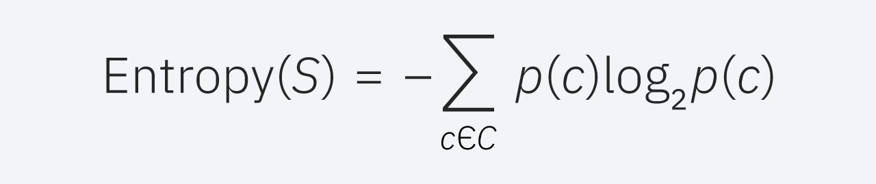
Decision Tree Entropy Entropy is a concept that stems from information theory, which measures the impurity of the sample values. It is defined with by the following formula, where:

Slide 5
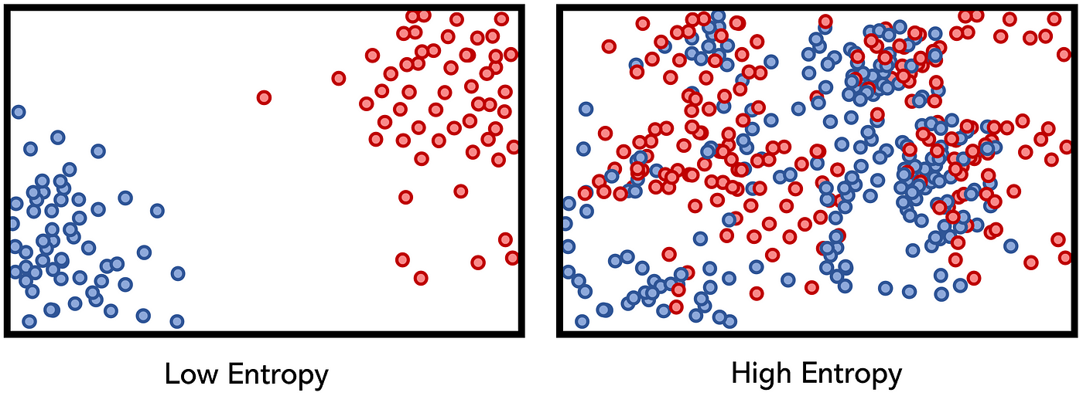

Slide 6
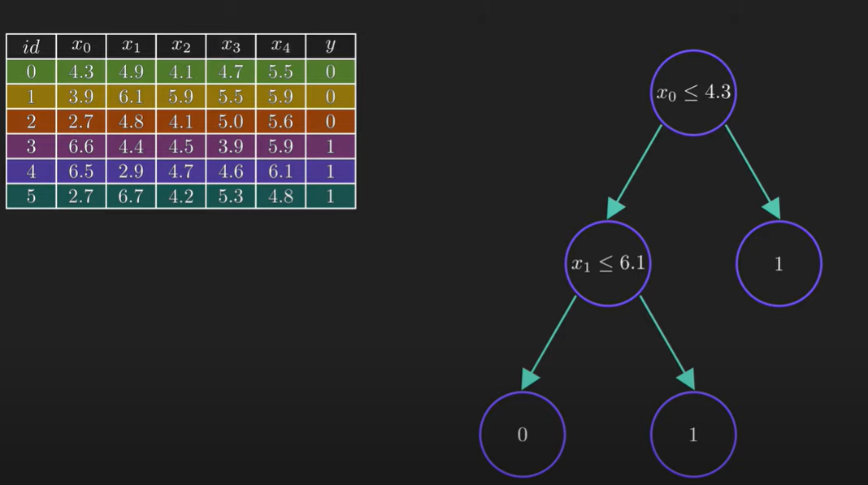
Decision Tree

Slide 7
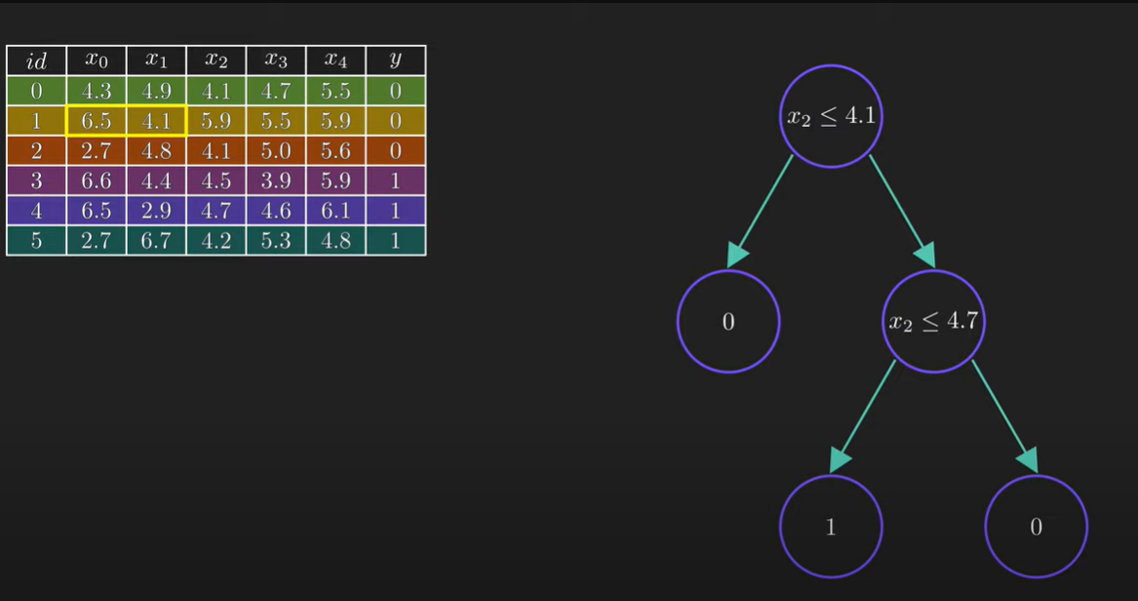
Decision Tree

Slide 8
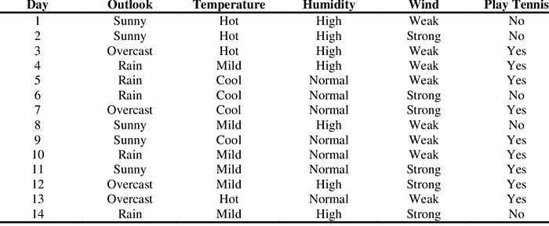

Slide 9
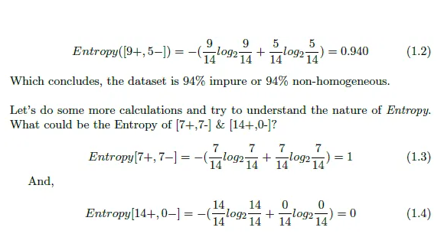
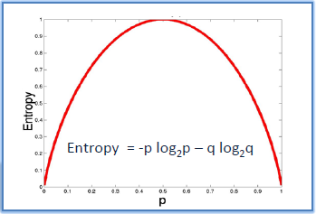
Decision Tree - Entropy

Slide 10
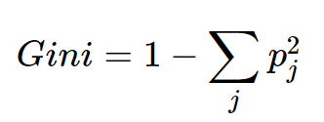
Gini Impurity
Gini impurity is the probability of incorrectly classifying a random data point in a dataset. It is an impurity metric since it shows how the model differs from a pure division.

Slide 11
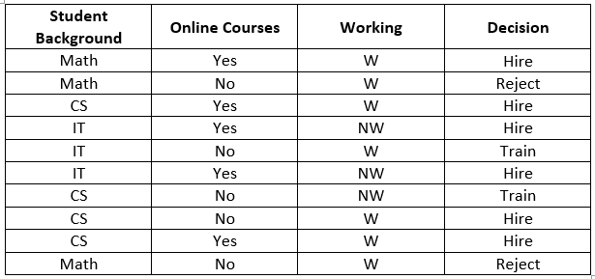

Gini Impurity
Hire - 6 instances.
Reject - 2 instances.
Train - 2 instances.
So the Gini Impurity on Decision will be:

Slide 12
Decision Tree - How to choose the best attribute at each node
Entropy values can fall between 0 and 1. If all samples in data set, S, belong to one class, then entropy will equal zero. If half of the samples are classified as one class and the other half are in another class, entropy will be at its highest at 1.
Information gain represents the difference in entropy before and after a split on a given attribute. The attribute with the highest information gain will produce the best split as it’s doing the best job at classifying the training data according to its target classification.

Slide 13
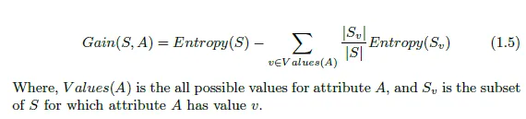
Information Gain
information gain, is simply the expected reduction in entropy caused by partitioning the data set. The information gain of an attribute A relative to a collection of data set S, is defined as-

Slide 14
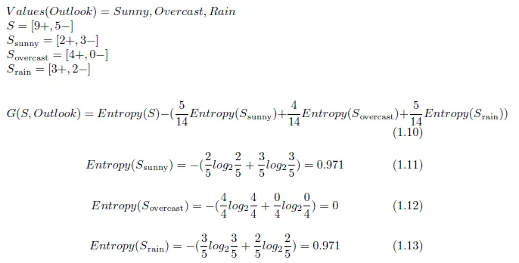
Information Gain

Slide 15
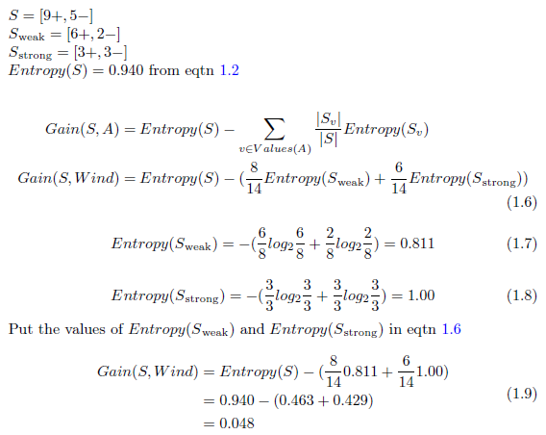
Information Gain

Slide 16
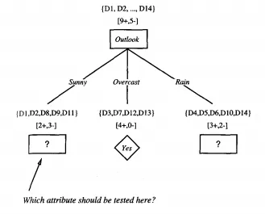
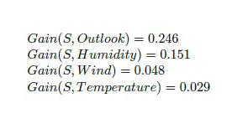
Information Gain
The most useful attribute is “Outlook” as it is giving us more information than others. So, “Outlook” will be the root of our tree.

Slide 17
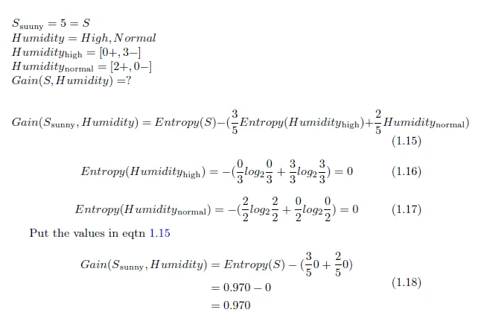
Information Gain for second level

Slide 18
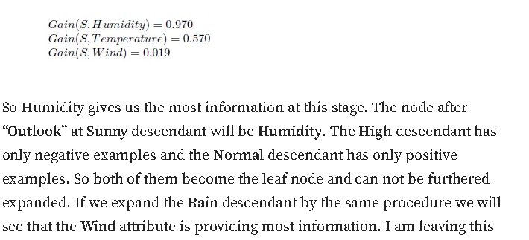
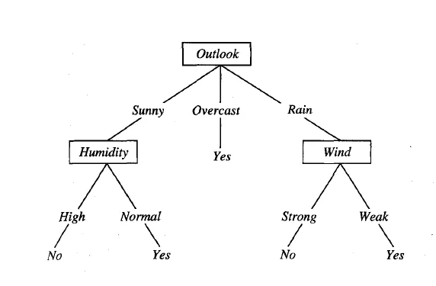
Information Gain for second level

Slide 19
Decision Tree
Advantages
-Easy to interpret: The Boolean logic and visual representations of decision trees make them easier to understand and consume. The hierarchical nature of a decision tree also makes it easy to see which attributes are most important, which isn’t always clear with other algorithms, like neural networks.
-Little to no data preparation required: Decision trees have a number of characteristics, which make it more flexible than other classifiers. It can handle various data types—i.e. discrete or continuous values, and continuous values can be converted into categorical values through the use of thresholds. Additionally, it can also handle values with missing values, which can be problematic for other classifiers, like Naïve Bayes.
-More flexible: Decision trees can be leveraged for both classification and regression tasks, making it more flexible than some other algorithms. It’s also insensitive to underlying relationships between attributes; this means that if two variables are highly correlated, the algorithm will only choose one of the features to split on.

Slide 20
Decision Tree
Disadvantages
- Prone to overfitting: Complex decision trees tend to overfit and do not generalize well to new data. This scenario can be avoided through the processes of pre-pruning or post-pruning. Pre-pruning halts tree growth when there is insufficient data while post-pruning removes subtrees with inadequate data after tree construction.
- High variance estimators: Small variations within data can produce a very different decision tree. Bagging, or the averaging of estimates, can be a method of reducing variance of decision trees. However, this approach is limited as it can lead to highly correlated predictors.
- More costly: Given that decision trees take a greedy search approach during construction, they can be more expensive to train compared to other algorithms.

Slide 21
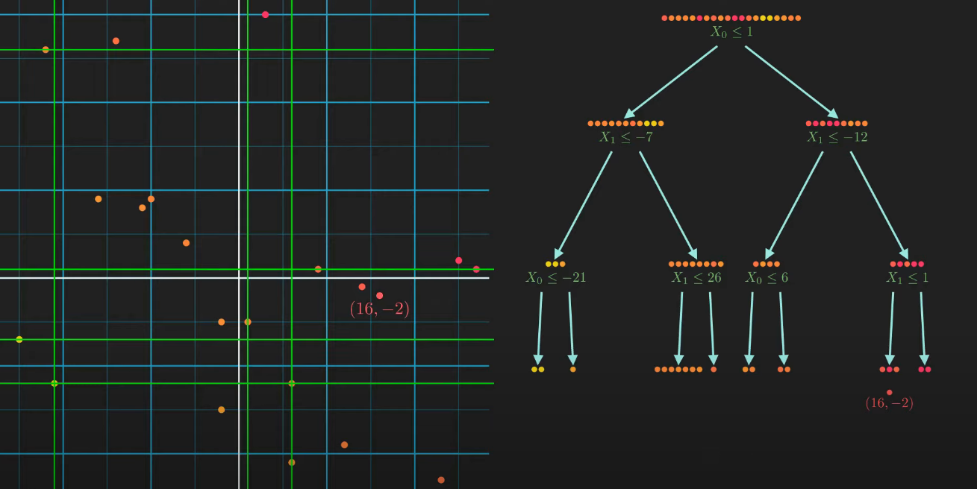

Slide 22
Random Forest
Random Forest is a popular ensemble learning method that combines multiple decision trees to improve prediction accuracy and reduce overfitting. It's a versatile algorithm that can be applied to both classification and regression problems.

Slide 23
Random Forest
How it works ?
Bootstrap Sampling: The algorithm randomly selects multiple samples (with replacement) from the original dataset. Each sample is used to train a separate decision tree.
Feature Randomization: At each node of each decision tree, only a random subset of features is considered for splitting. This helps to decorrelate the trees and reduce overfitting.
Tree Growth: Each decision tree is grown to its maximum depth without pruning.
Prediction: To make a prediction for a new instance, the predictions of all trees are combined. For classification, the most frequent class among the predictions is chosen. For regression, the average of the predictions is taken.

Slide 24
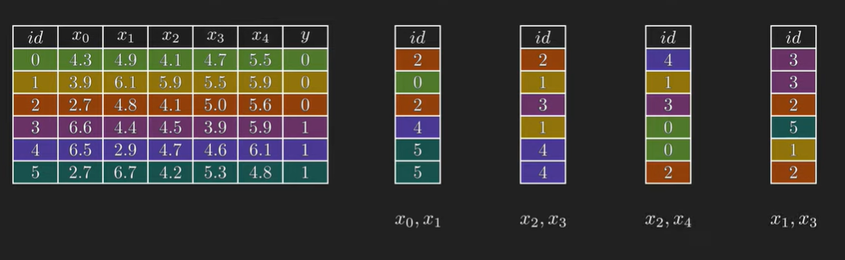
Random Forest

Slide 25
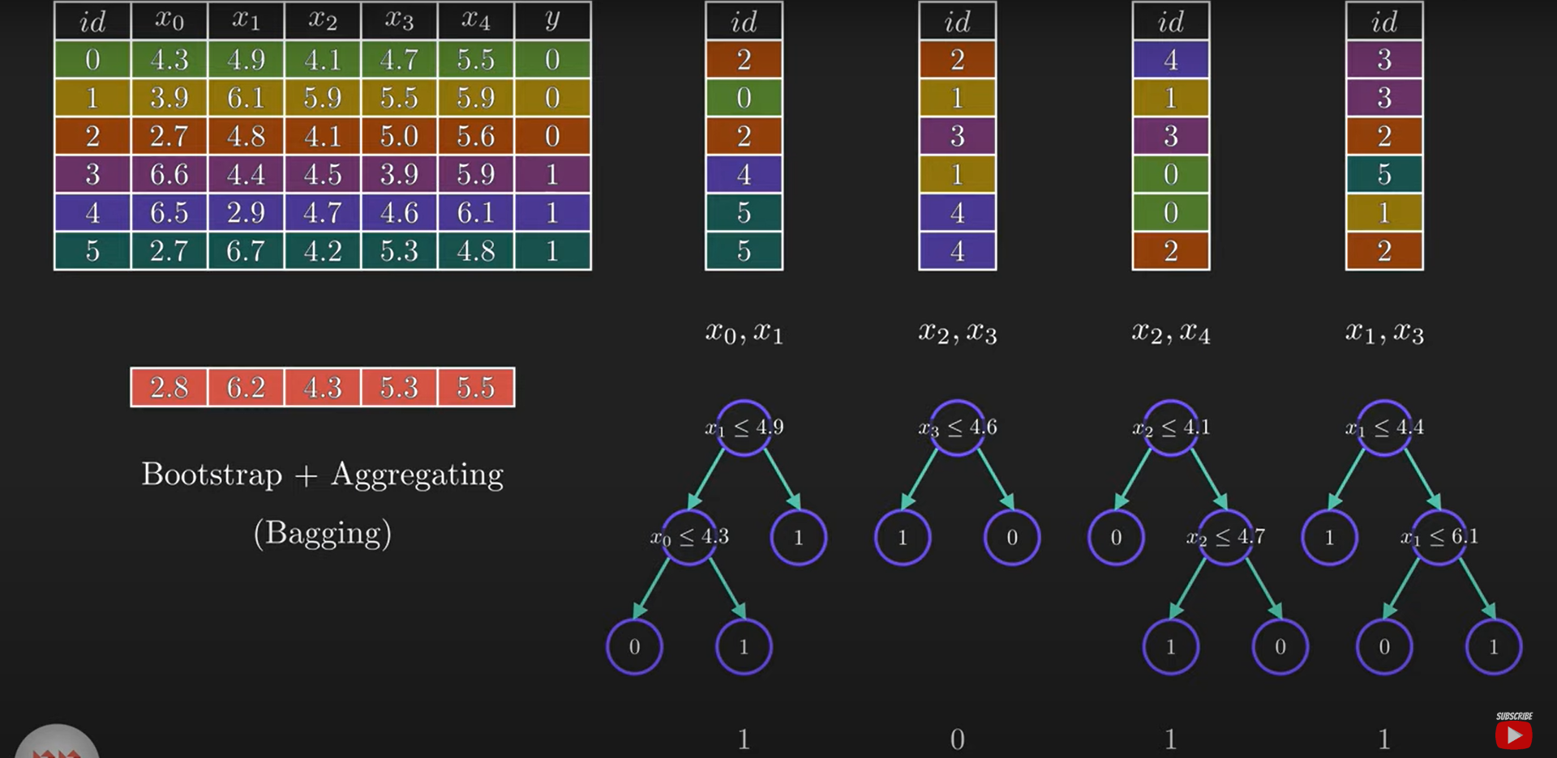
Random Forest

Slide 26
Random Forest
Advantages
Reduced Overfitting: By averaging the predictions of multiple trees, random forests can help to reduce overfitting, which is a common problem with decision trees.
Improved Accuracy: Random forests often achieve higher accuracy than individual decision trees, especially on large and complex datasets.
Robustness: Random forests are relatively robust to noise and outliers in the data.
Feature Importance: The algorithm can be used to assess the importance of different features in the prediction task.

Slide 27
Ensemble methods Random Forest
Disadvantage
Computational Cost: Training a random forest can be computationally expensive, especially for large datasets with many features.
Interpretability: While random forests can be more accurate than individual decision trees, they can be less interpretable due to the complexity of the ensemble.

Slide 28
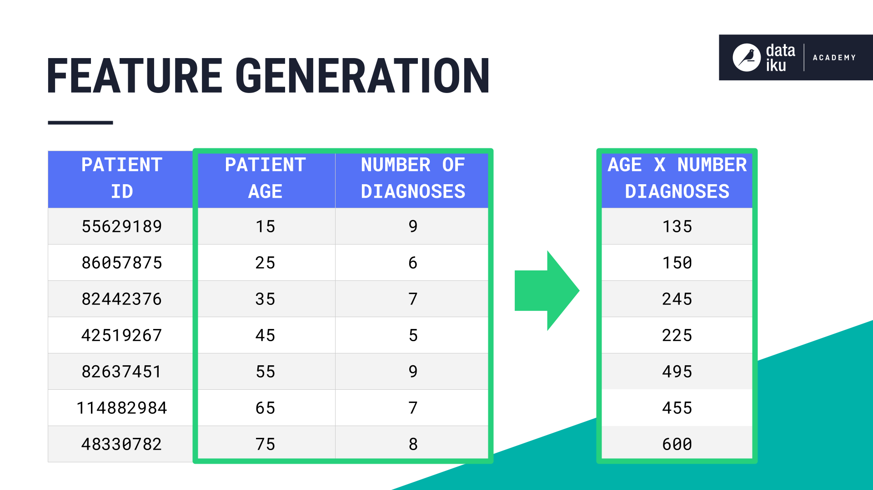

Slide 29
Feature Generation
Feature Generation (also known as feature construction) is the process of transforming features into new features that better relate to the target.
Examples of Feature Generation techniques
A transformation is a mapping that is used to transform a feature into a new feature. The right transformation depends on the type and structure of the data, data size and the goal. This can involve transforming single feature into a new feature using standard operators like log, square, power, exponential, reciprocal, addition, division, multiplication etc.

Slide 30
Why Feature Generation?
Enhanced Model Performance: Well-crafted features can significantly improve a model's ability to learn and make accurate predictions.
Reduced Feature Engineering: By generating informative features, you might be able to reduce the need for extensive feature engineering.
Better Interpretability: Generated features can sometimes provide insights into the underlying relationships between variables.

Slide 31
Example: Feature Generation
For a Customer Churn Prediction Model
Given a dataset with customer information (age, tenure, monthly bill, etc.)
You could generate new features like:
Customer tenure in month: Divide tenure by 12.
Around Monthly bill per year: Multiply monthly bill by 12.
Age group: Categorize age into bins (e.g., young, middle-aged, elderly).
Interaction between tenure and monthly bill: Multiply tenure by monthly bill.

Slide 32
Tips for Effective Feature Generation
Domain Knowledge: Leverage your understanding of the problem domain to create meaningful features.
Experimentation: Try different feature generation techniques and evaluate their impact on model performance.
Feature Selection: After generating new features, consider using feature selection techniques to identify the most relevant ones.
Avoid Overfitting: Be cautious of creating too many features, as it can lead to overfitting.

Slide 33
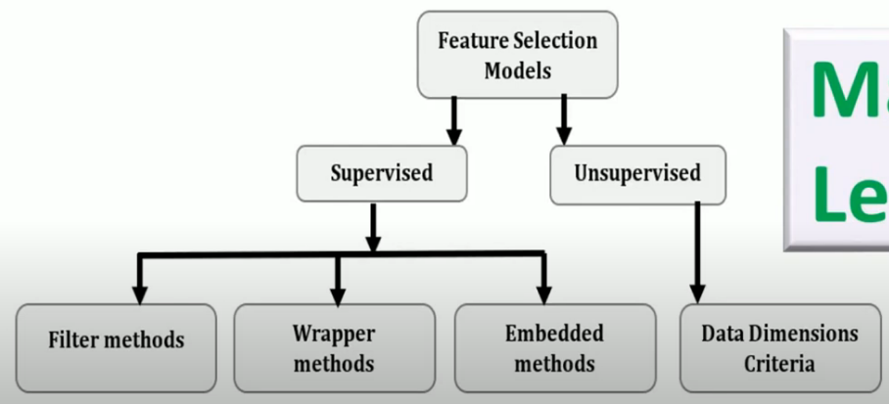
Feature Selection algorithms

Slide 34
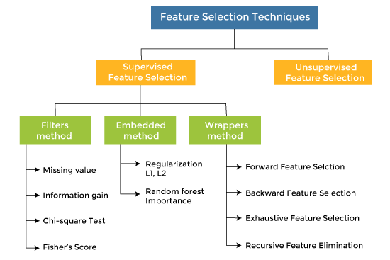

Slide 35
Feature Selection Methods
Method | Description | Advantages
Filter | Uses statistical tests to rank features | Simple and fast
Wrapper | Trains a model on different subsets of features | Accurate
Embedded | Selects features as part of the model training process | Accurate and efficient

Slide 36
Feature Selection
Advantages:
Improves accuracy of machine learning models
Reduces overfitting
Reduces training time
Improves interpretability of machine learning models
Disadvantages:
Can be computationally expensive
May not always find the optimal subset of features

Slide 37
Filters
At buffet, you wouldn't just take everything on a plate right?
Filter methods are just like this, only focusing on specific traits of each feature.
statistical tests and measures to identify features that seem relevant based on their correlation with target variable.
chi-square tests, information gain, and mutual dependence methods.
Objective : To have quick elimination of irrelevant features and in terms of process, features are evaluated based on statistical measures or mathematical functions.
when to use filter methods: A) when you have higher dimensional data with a larger number of features, B) the pre-processing step as it acts as a preliminary filter before diving into more intricate methods.

Slide 38
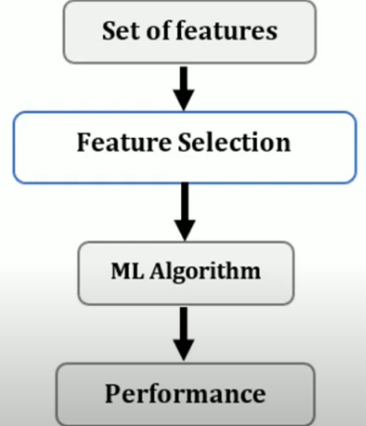
Filters
Advantages
they are computationally cheaper as compared to others.
they have the fastest running time with the ability of good generalization.
It is also easily scaled to high dimensional data sets.
Disadvantages
no interaction with classification models can happen for feature selection.
it mostly ignores feature dependencies and considers each feature separately in case of univariate techniques.

Slide 39
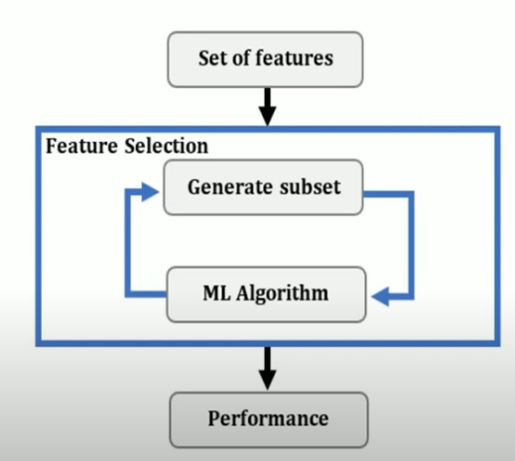
Wrappers
It like trial and error.
Imagine building your plate one bit at a time, testing each feature and seeing how it affects your overall dining experience.
These methods train predictive models with different combinations of features and then choose the set that makes the tastiest model ideally choosing the one with the highest accuracy or lowest error.
Methods : forward selection and recursive elimination.
Objective: To evaluate subsets of features as a group and in terms of process, it employs predictive models to assess feature subsets.
when to use wrapper methods:
when dealing with model-specific optimization
small to medium data sets.

Slide 40
Wrappers
Advantages:
it interacts with the classifier for feature selection.
more comprehensive search of feature set space can happen with it.
it considers feature dependencies and is offering better generalization than filter approach.
Disadvantages:
It surely has high computational cost alongside long running time.
It also poses higher risk of overfitting as compared to filter and embedded methods.
it is computationally more unfeasible with increased number of features.

Slide 41
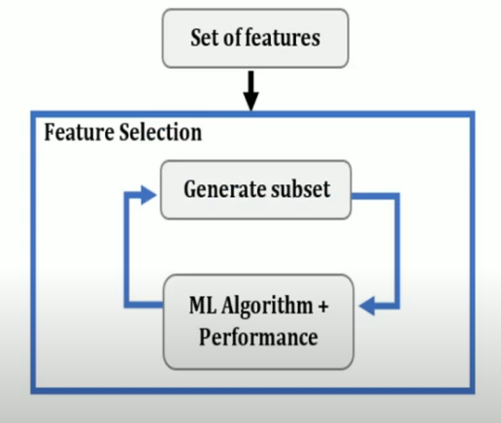
Embedded methods
Embedded methods blend the best of both worlds.
They're like having a star chef guide you through the menu, highlighting hidden gems.
These methods build the model and perform feature selection.
They shrink the weight of irrelevant features or prune them all together, resulting in a leaner, meaner model.
Methods : tree-based methods
Objective: To incorporate feature selection within the model training process and in terms of process, features are selected as the model learns during the training.

Slide 42
Embedded methods
when to use wrapper methods:
A) when dealing with integrated learning,
B) when dealing with large data sets as it efficiently handles substantial amounts of data during the model building process.

Slide 43
Embedded methods
Advantages :
they're computationally less expensive as compared to wrapper methods.
They offer faster running time as compared to wrapper and interacts with the classification model for feature selection.
It offers a lower risk of overfitting as compared to wrapper.
Disadvantages:
The identification of a small set of features may be problematic in this method.

